Slide 1


Slide 2
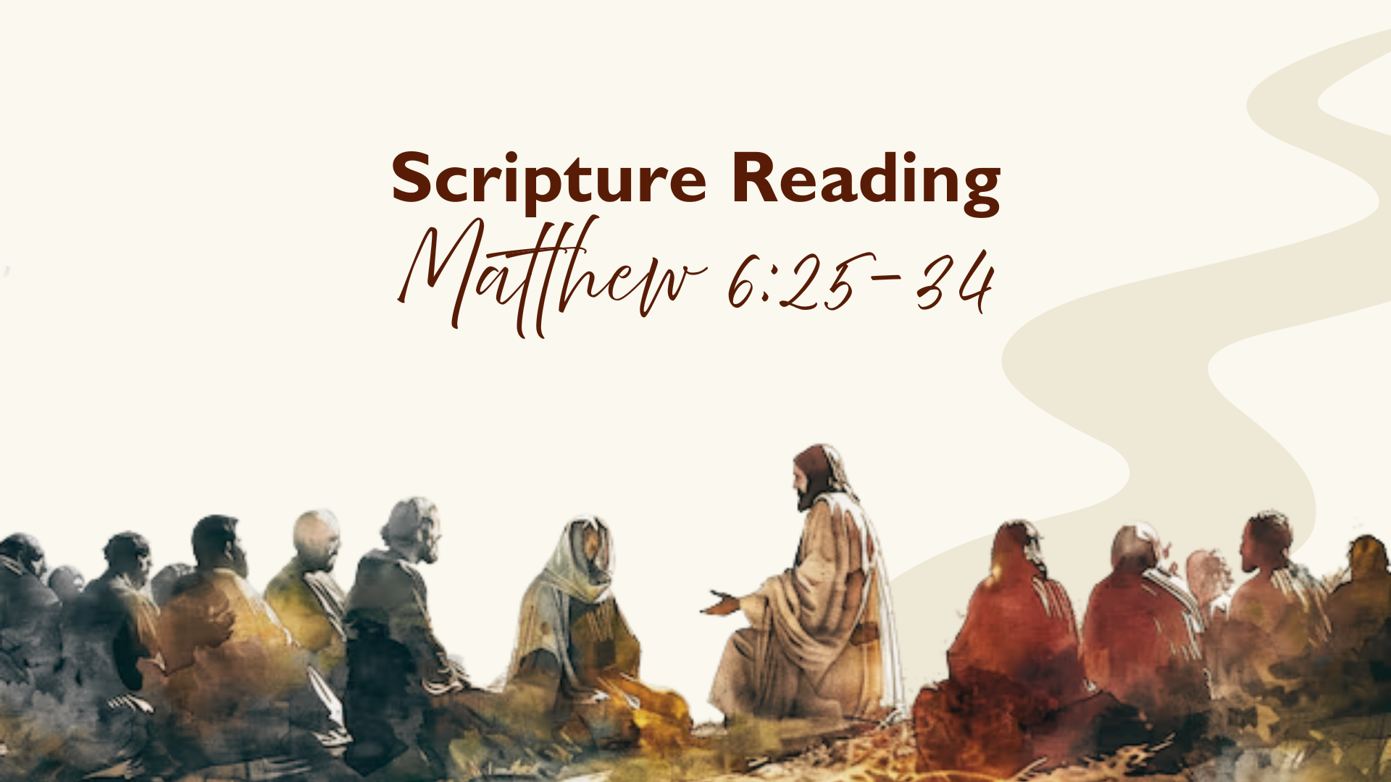

Slide 3
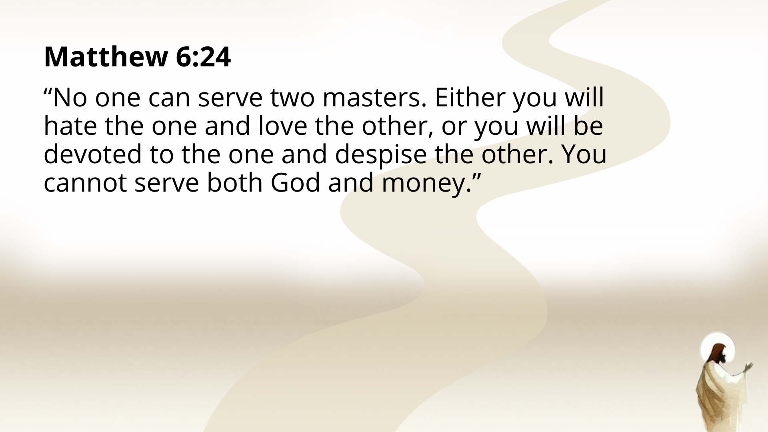

Slide 4
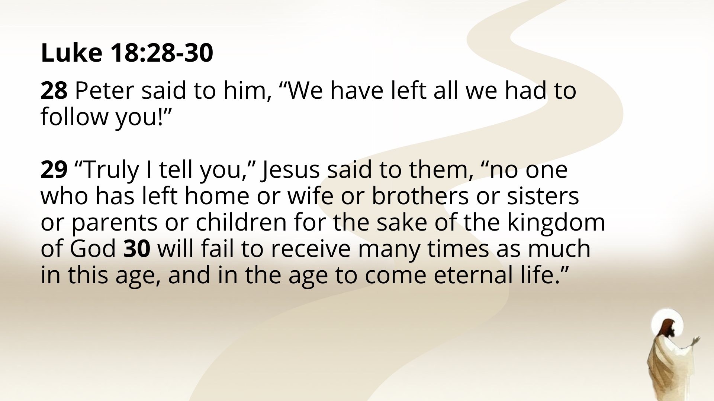

Slide 5
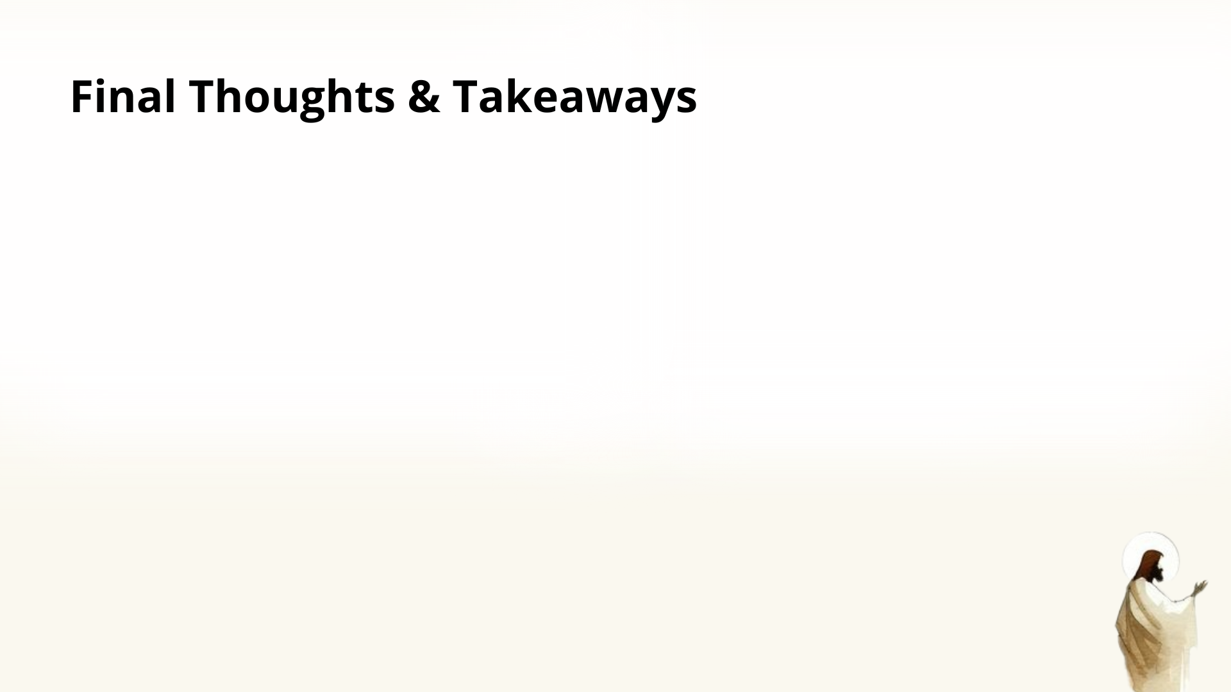

Slide 6
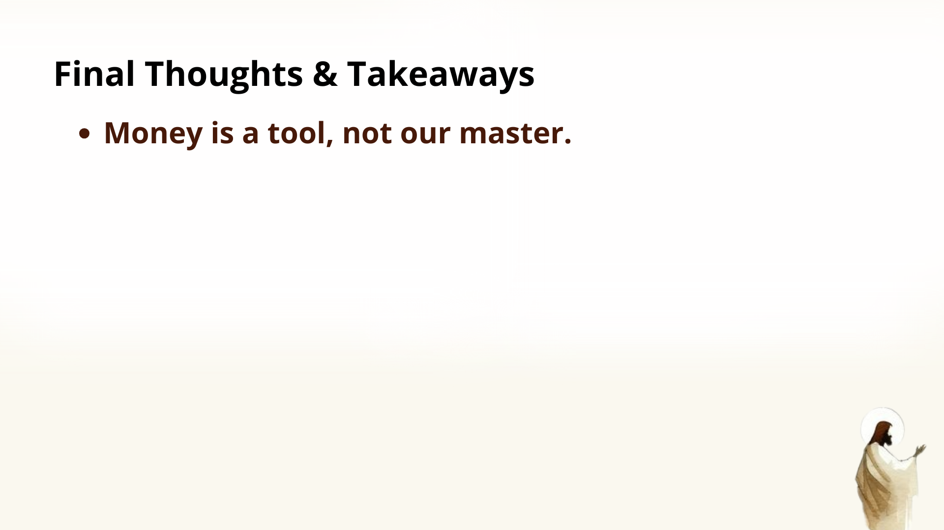

Slide 7
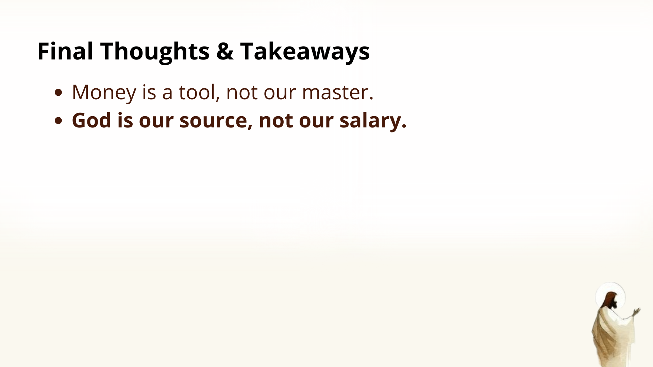

Slide 8
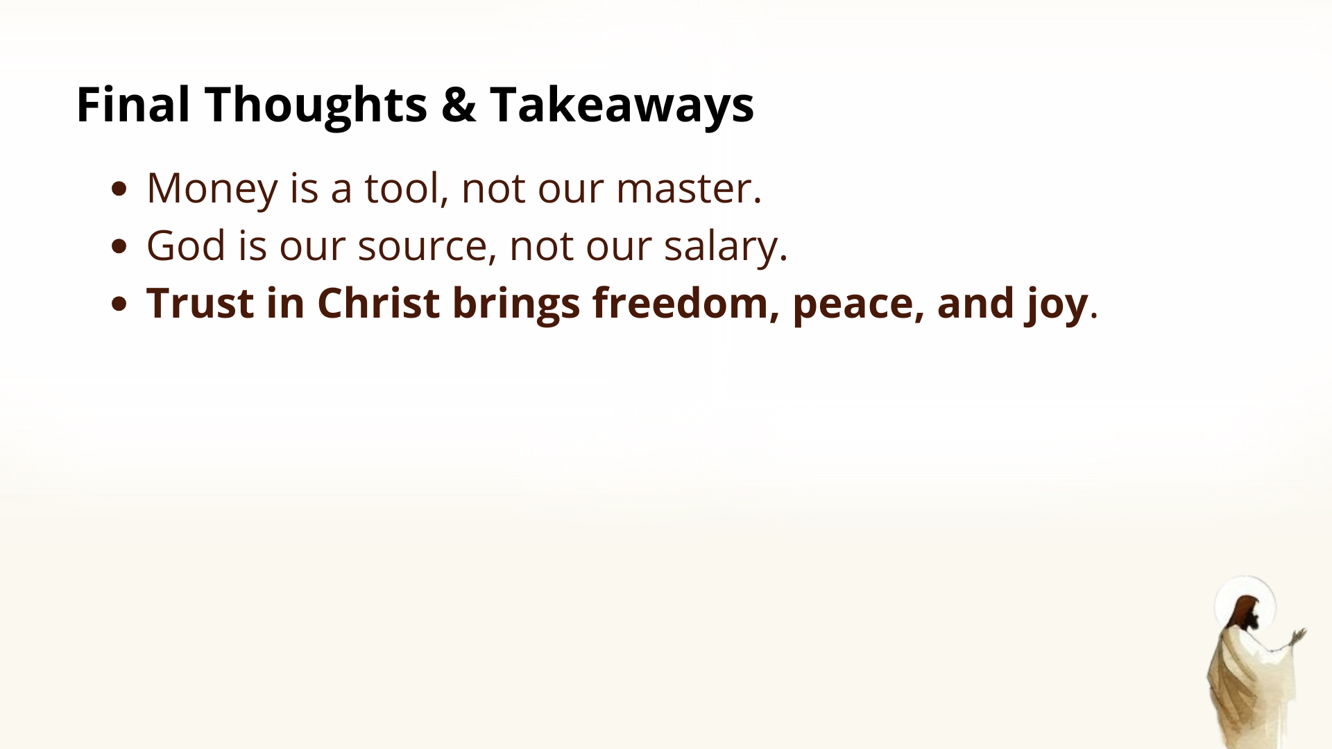

Slide 9
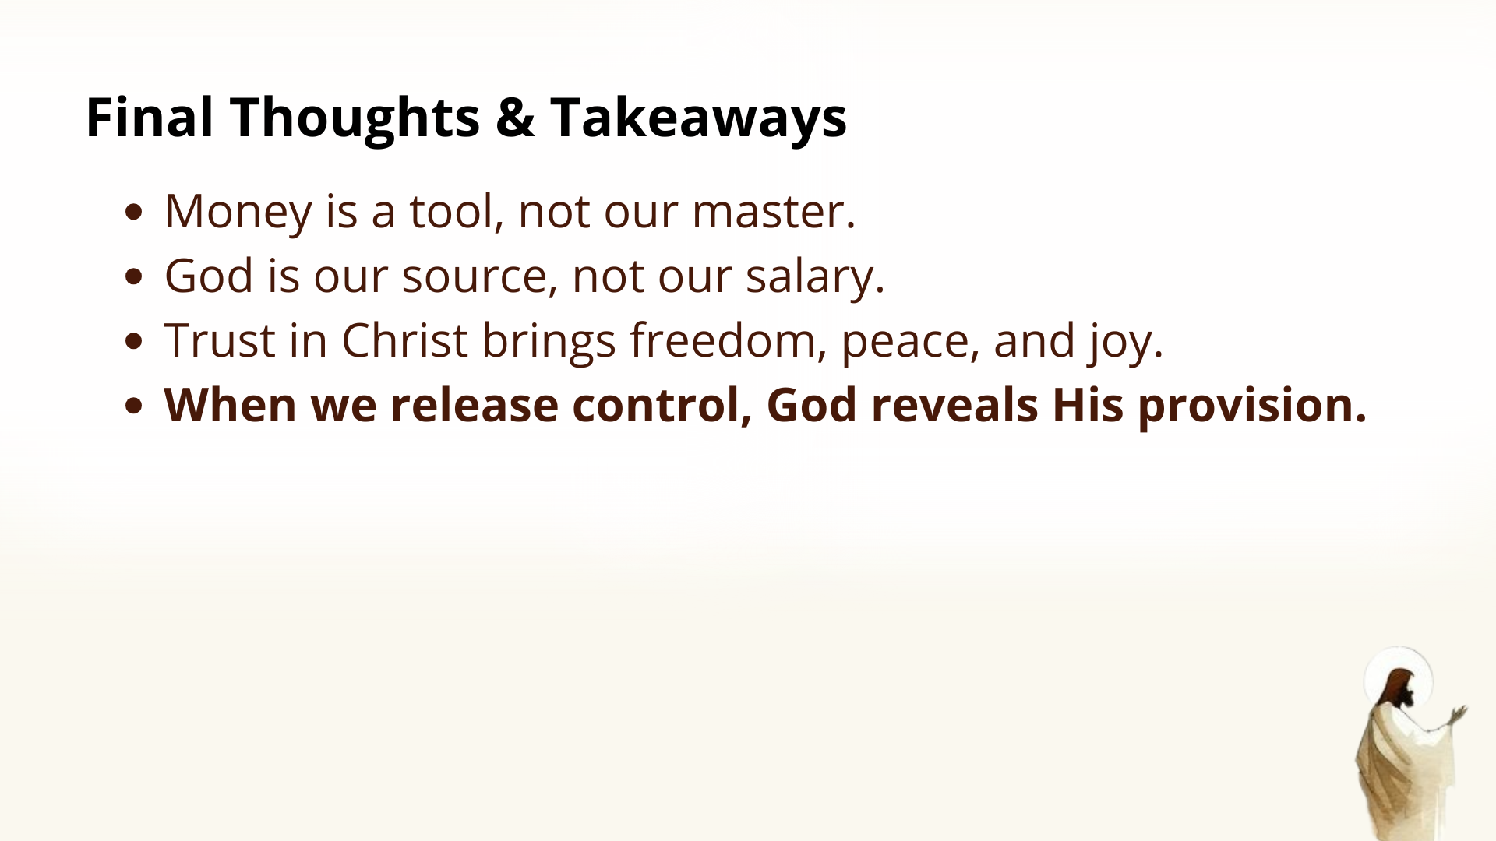

Slide 10
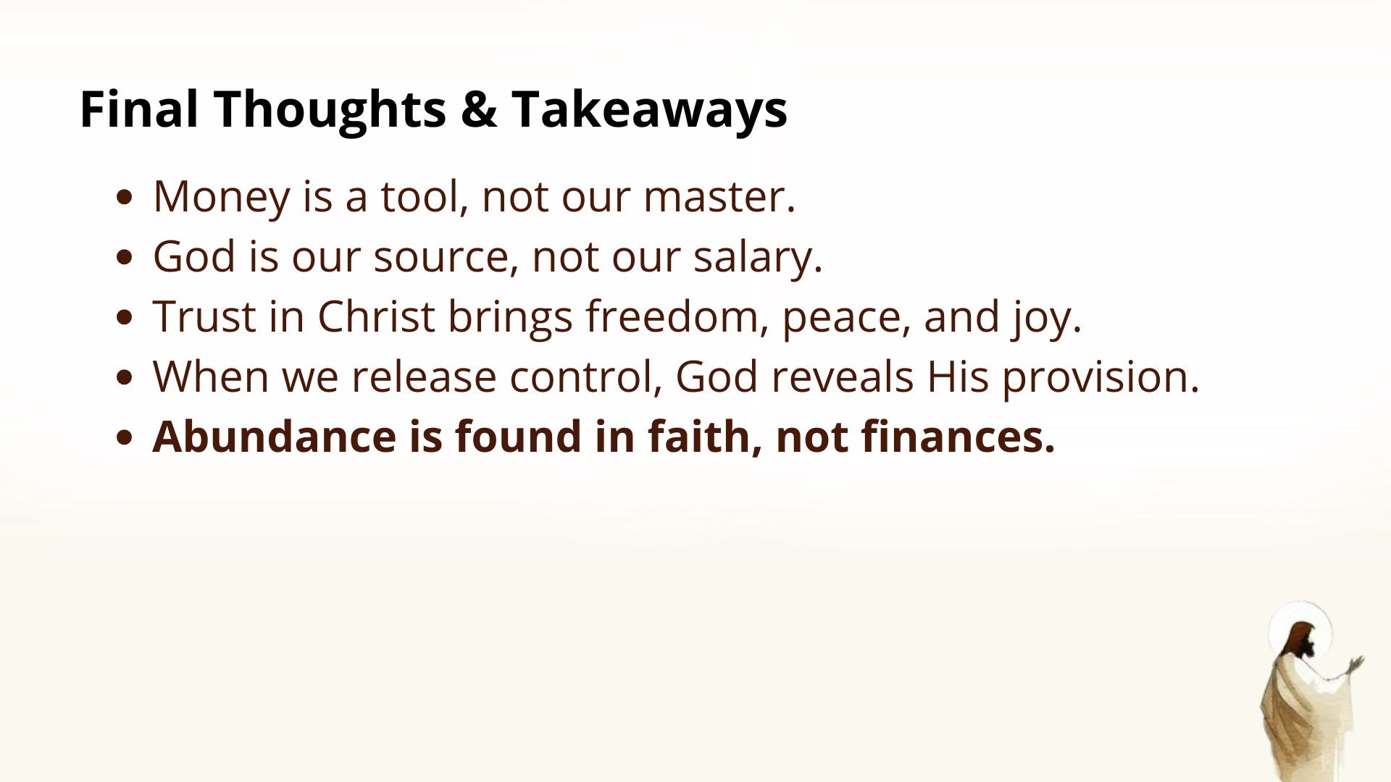

Slide 11


Slide 12


Slide 13


Slide 14


Slide 15
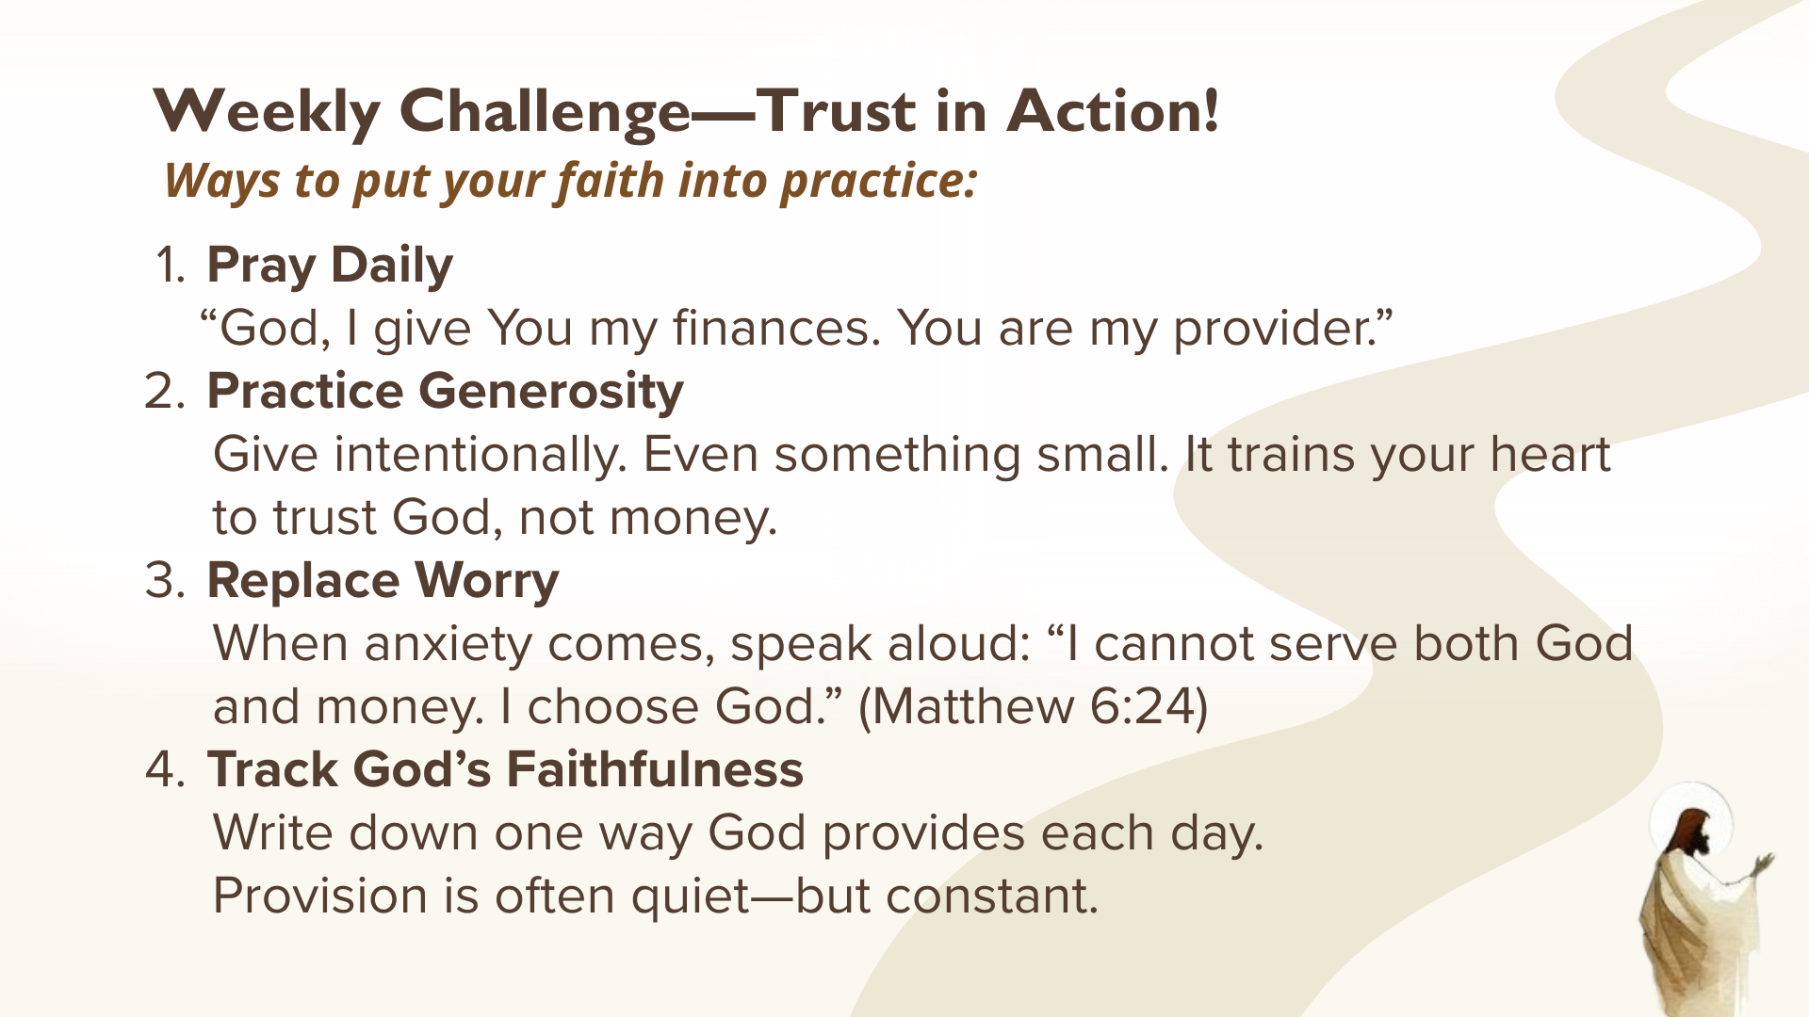

Slide 16

Notes:
Benediction
Brothers and sisters, you have heard the words of Jesus and the call to follow him. The path is narrow, but it leads to life. Remember that Christ walks with you, the Father surrounds you, and the Spirit empowers you. Therefore, go in peace, to love and serve the Lord. Amen.

